Slide 1
欢迎领导莅临
Welcome!

Slide 2
KSSP 精益提升项目启动会
Kick-off Meeting of
Lean Optimization Project
Nov. 1st 2016

Slide 3
KSSP 精益项目启动会议程
Kick-off Meeting Agenda
主持 Host ：王国祥 Wang Guoxiang
议程 Agenda：
序号 No. | 自 From | 至 To | 内容 Subject | 发言人 Addressor
1 | 15:30 | 15:35 | 项目简介 Project Background | 王国祥 Wang Guoxiang
2 | 15:35 | 15:45 | 技术方案 Technical Solution | 武智堂 Wu Zhitang
3 | 15:45 | 15:50 | 华域汽车运营控制部执行总监讲话 Speech - HASCO OMD Director | 华慕文 Hua Muwen
4 | 15:50 | 16:00 | KSSP总经理讲话 Speech - KSSP GM | 汪若英 Wang Ruoying Ralf Buschbeck
5 | 16:00 | 16:30 | 华域领导讲话 Speech - HASCO GM | 张海涛 Zhang Haitao
15:00—15:30 现场参观 Plant Tour

Slide 4
目录 Content
1
项目简介
Project Background
2
技术方案
Technical Solution
3
领导讲话
Leader Speech

Slide 5




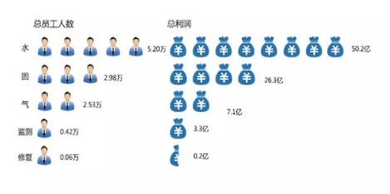

项目简介 Project Background 1/5
KS现状 KS Status Quo
项目内容 Project Content
项目目标 Project Target
项目周期 Project Period
组织结构 Organization Structure
存货周转次数(9月底) = 6.9 次
Inventory Turnover (up to Sep.30th) = 6.9 times
人均月产出 = 1279 件
Monthly output (per capita )
= 1279 pcs
TEEP = 63.8%
OEE = 74.3%
(9月底/up to Sep.30th)

Slide 6
存货周转次数 = 销售成本 / 存货平均余额
2015 | Jan | Feb | Mar | Apr | May | Jun | Jul | Aug | Sep | Oct | Nov | Dec | Ave
销售成本 | 1,592,785,120.20 | 1,571,162,378.10 | 1,553,451,504.52 | 1,534,577,977.95 | 1,506,306,391.08 | 1,460,544,070.28 | 1,415,139,165.99 | 1,356,100,413.35 | 1,327,323,733.19 | 1,329,431,062.36 | 1,340,643,364.97 | 1,336,775,887.65 | 1,443,686,755.80
存货平均余额 | 218,059,621.59 | 212,415,474.37 | 210,097,635.71 | 210,035,246.23 | 210,379,229.94 | 210,874,106.43 | 211,539,008.06 | 211,832,961.17 | 211,499,011.25 | 211,148,510.65 | 210,478,801.17 | 209,760,434.27 | 211,510,003.40
ITO | 7.30 | 7.40 | 7.39 | 7.31 | 7.16 | 6.93 | 6.69 | 6.40 | 6.28 | 6.30 | 6.37 | 6.37 | 6.82
2016 | Jan | Feb | Mar | Apr | May | Jun | Jul | Aug | Sep | Oct | Nov | Dec | Ave
销售成本 | 1,528,823,429.52 | 1,343,237,903.40 | 1,330,412,383.32 | 1,301,788,380.39 | 1,281,494,975.40 | 1,251,282,003.36 | 1,245,102,645.38 | 1,252,342,377.89 | 1,251,199,582.16 |  |  |  | 1,309,520,408.98
存货平均余额 | 193,070,061.22 | 185,476,530.32 | 181,959,244.62 | 180,961,763.60 | 180,833,850.78 | 182,825,721.45 | 184,389,891.39 | 184,123,959.06 | 184,036,235.32 |  |  |  | 184,186,361.97
ITO | 7.92 | 7.24 | 7.31 | 7.09 | 6.84 | 6.75 | 6.80 | 6.80 | 7.92 |  |  |  | 7.11

Slide 7
人均产出 = 入库总数 / 总人数
2015 | Jan | Feb | Mar | Apr | May | Jun | Jul | Aug | Sep | Oct | Nov | Dec | Ave
入库数 | 1699470 | 1376050 | 1703032 | 1634082 | 1715346 | 1478839 | 1243163 | 1164985 | 1378596 | 1677178 | 1804275 | 1843833 | 1559904
总人数 | 1303 | 1284 | 1293 | 1354 | 1329 | 1281 | 1257 | 1262 | 1174 | 1187 | 1217 | 1259 | 1267
人均 产出 | 1304 | 1072 | 1317 | 1207 | 1291 | 1154 | 989 | 923 | 1174 | 1413 | 1483 | 1465 | 1233
2016 | Jan | Feb | Mar | Apr | May | Jun | Jul | Aug | Sep | Oct | Nov | Dec | Ave
入库数 | 1740044 | 1336328 | 1737702 | 1522400 | 1651941 | 1561388 | 1686888 | 1736704 | 1673687 |  |  |  | 1627454
总人数 | 1311 | 1288 | 1285 | 1284 | 1277 | 1265 | 1255 | 1250 | 1245 |  |  |  | 1273
人均 产出 | 1327 | 1038 | 1352 | 1186 | 1294 | 1234 | 1344 | 1389 | 1344 |  |  |  | 1279

Slide 8
OEE = 时间开动率 * 性能开动率 * 合格品率
2015 | Jan | Feb | Mar | Apr | May | Jun | Jul | Aug | Sep | Oct | Nov | Dec | Ave
时间 开动率 |  |  |  |  |  |  |  |  |  |  | 91.24% | 91.02% | 91.13%
性能 开动率 |  |  |  |  |  |  |  |  |  |  | 85.60% | 85.29% | 85.45%
合格品率 |  |  |  |  |  |  |  |  |  |  | 95.10% | 95.59% | 95.34%
OEE |  |  |  |  |  |  |  |  |  |  | 74.28% | 74.20% | 74.24%
2016 | Jan | Feb | Mar | Apr | May | Jun | Jul | Aug | Sep | Oct | Nov | Dec | Ave
时间 开动率 | 90.64% | 88.68% | 87.76% | 88.81% | 88.53% | 90.27% | 88.41% | 90.08% | 91.51% |  |  |  | 89.41%
性能 开动率 | 89.38% | 87.37% | 89.71% | 88.35% | 85.36% | 84.61% | 86.68% | 86.95% | 87.22% |  |  |  | 87.29%
合格品率 | 95.66% | 95.35% | 95.28% | 95.15% | 95.51% | 95.65% | 93.81% | 95.15% | 94.90% |  |  |  | 95.16%
OEE | 77.50% | 73.88% | 75.01% | 74.65% | 72.17% | 73.06% | 71.89% | 74.53% | 75.75% |  |  |  | 74.27%

Slide 9
Line 6 OEE = Line 6时间开动率 * Line 6性能开动率 * Line 6合格品率
2015 | Jan | Feb | Mar | Apr | May | Jun | Jul | Aug | Sep | Oct | Nov | Dec | Ave
时间 开动率 |  |  |  |  |  |  |  |  |  |  | 99.07% | 98.82% | 98.94%
性能 开动率 |  |  |  |  |  |  |  |  |  |  | 94.58% | 95.92% | 95.25%
合格品率 |  |  |  |  |  |  |  |  |  |  | 96.62% | 95.50% | 96.06%
OEE |  |  |  |  |  |  |  |  |  |  | 90.53% | 90.52% | 90.53%
2016 | Jan | Feb | Mar | Apr | May | Jun | Jul | Aug | Sep | Oct | Nov | Dec | Ave
时间 开动率 | 88.39% | 92.37% | 95.82% | 78.52% | 96.84% | 96.04% | 95.64% | 92.55% | 90.79% |  |  |  | 91.88%
性能 开动率 | 94.90% | 91.76% | 93.53% | 95.91% | 91.86% | 95.96% | 94.88% | 97.06% | 105.41% |  |  |  | 95.69%
合格品率 | 95.86% | 94.87% | 95.52% | 94.20% | 96.20% | 95.03% | 94.93% | 95.35% | 94.59% |  |  |  | 95.17%
OEE | 80.40% | 80.41% | 85.60% | 70.94% | 85.58% | 87.57% | 86.14% | 85.65% | 90.53% |  |  |  | 83.65%

Slide 10
项目简介 Project Background 2/5
KS现状 KS Status Quo
精益VSM分析，现场改进
Lean VSM analysis & Improve on-site
项目内容 Project Content
项目目标 Project Target
项目周期 Project Period
组织结构 Organization Structure
人均产出低
Low per capita
精益
提升
Lean
Optimization
存货周转次数低
无系统自动预警系统
Low inventory turnover &
No automotive warning system
OEE 低
Low OEE
库存分析，导入WMS系统
Inventory analysis & Login WMS system
效率/浪费分析，导入MES系统,生产实时监控,提升效率
Efficiency/Waste analysis
Login MES system
Real time monitoring & improve efficiency

Slide 11




项目简介 Project Background 3/5
KS现状 KS Status Quo
项目内容 Project Content
项目目标 Project Target
项目周期 Project Period
组织结构 Organization Structure
智能工厂 Intelligent factory
KSSP
(启动中)
样板
BM
提升
CIP
KSCQ
(方案中)
数据收集，信息可视化，生产/质量/库存实时监控
Data collection, Information visualization, Real time monitoring (production, quality, inventory)
将上海工厂标准模式运用到重庆工厂
Apply KSSP plant mode into KSCQ plant
生产控制系统化,及时调整
Systematic production control
Adjust in time
使用相关系统，保持高生产效率 use related system, keep high productivity
库存下降/劳动生产率提升
Decline inventory / Promote productivity

Slide 12











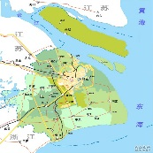
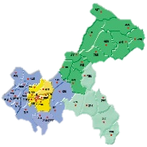
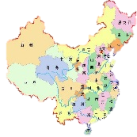
项目简介 Project Background 3/5
KS现状 KS Status Quo
项目内容 Project Content
项目目标 Project Target
项目周期 Project Period
组织结构 Organization Structure
实时监控
Real time monitoring
生产 质量 库存 设备
深度分析
Profundity Analysis
OEE OTD MTTB
全面目视
Overall Vision
报表 中央监控 移动手机
数据库
Database
大数据分析
……
智能KS工厂愿景 Vision of KS Plant Intellectualization
全面互联
Comprehensive Interconnection
高效运营
High-efficiency Operation
KSSP
上海
KSCQ
重庆
KS Future
未来
……

Slide 13
项目简介 Project Background 3/5
KS现状 KS Status Quo
项目内容 Project Content
项目目标 Project Target
项目周期 Project Period
组织结构 Organization Structure
区域 Area | 分步实施 Steps | ①现场改善 Improvements | 指标 | ②信息系统 System | 周期 Period | 出资方 Stakeholder |  | 费用 Cost
 |  |  |  |  |  | 咨询 Consulting | 软件/硬件 Software Hardware
KSSP | I期 Phase 1 | 人均产出 Labor efficiency | +20% | 仓库管理 WMS 物料拉动 Material pull 生产监控 Production monitor | 8个月 8 months | 华域支持 HASCO support 800,000.00 | 科尔本 KS | 1,940,000.00
 |  | 库存 Inventory | -20%
 |  | 样板线 OEE Pilot line OEE | +25%
KSSP | II期 Phase 2 | 库存 Inventory | -20% | 高级排产 APS 质量管理 Quality management 采购管理 Purchase management | 8个月 8 months | 科尔本 KS |  | 4,000,000.00
 |  | 车间 OEE Workshop OEE | +25%
KSSP | III期 Phase 3 | 库存 Inventory | -20% | 能源管理 Energy management 设备管理 Equipment management | 8个月 8 months | 科尔本 KS |  | 1,810,000.00
 |  | 全厂 OEE Plant OEE | +25%
总计 Total |  |  |  |  | 24个月 24 months |  |  | 7,750,000.00

Slide 14
项目简介 Project Background 3/5
KS现状 KS Status Quo
项目内容 Project Content
项目目标 Project Target
项目周期 Project Period
组织结构 Organization Structure
区域 Area | 分步实施 Steps | ①现场改善 Improvements | 指标 | ②信息系统 System | 周期 Period | 出资方 Stakeholder |  | 费用 Cost
 |  |  |  |  |  | 咨询 Consulting | 软件/硬件 Software Hardware
KSSP | I期 Phase 1 | 人均产出 Labor efficiency | +20% | 仓库管理 WMS 物料拉动 Material pull 生产监控 Production monitor | 8个月 8 months | 华域支持 HASCO support 800,000.00 | 科尔本 KS | 1,940,000.00
 |  | 库存 Inventory | -20%
 |  | 样板线 OEE Pilot line OEE | +25%
KSSP | II期 Phase 2 | 库存 Inventory | -20% | 高级排产 APS 质量管理 Quality management 采购管理 Purchase management | 8个月 8 months | 科尔本 KS |  | 4,000,000.00
 |  | 车间 OEE Workshop OEE | +25%
KSSP | III期 Phase 3 | 库存 Inventory | -20% | 能源管理 Energy management 设备管理 Equipment management | 8个月 8 months | 科尔本 KS |  | 1,810,000.00
 |  | 全厂 OEE Plant OEE | +25%
总计 Total |  |  |  |  | 24个月 24 months |  |  | 7,750,000.00

Slide 15
项目简介 Project Background 4/5
KS现状 KS Status Quo
项目内容 Project Content
项目目标 Project Target
项目周期 Project Period
组织结构 Organization Structure
阶段 Stage | 项目内容 Item | 2016 |  | 2017
 |  | Nov | Dec | Jan | Feb | Mar | Apr | May | Jun
0 | 准备阶段 Preparation
1 | OEE改善和提升 Improve OEE
2 | 精益库存降低 Decrease inventory
3 | 人均产出提升 Improve monthly output per capita
4 | WMS系统导入 Login WMS system
6 | MES安装调试 Install and adjust MES
7 | MES平台 MES platform
8 | 项目总结 Summary

Slide 16
项目简介 Project Background 5/5
KS现状 KS Status Quo
项目内容 Project Content
项目目标 Project Target
项目周期 Project Period
组织结构 Organization Structure
项目指导委员会
Project Guidance Committee
张海涛
Zhang haitao
马振刚
Ma Zhengang
华慕文
Hua Muwen
汪若英
Wang Ruoying
Ralf Buschbeck
Ralf Buschbeck
KS项目经理
王国祥(KS)/张俊杰(华域)
KS PM
Wang Guoxiang(KS)/Zhang Junjie(HASCO)
精益项目经理
谢陵春/裴夏(精工)
Lean PM
Xie Lingchun/Pei Xia
IT项目经理
武智堂/吴浩吉(力太)
Litai IT PM
Wu Zhitang/Wu Haoji
推进小组
实施小组
技术支持:
魏巍、李德清
硬件组长/包红亚
软件组长/林加旗
物流部
仓库
精益改善
热工
机加工
裴夏
欧阳延
James
工程师
周为
工程师
许焘
WMS系统 5人
接口开发 任涛
数据平台 蔡才源

Slide 17
目录 Content
2
技术方案
Technical Solution
1
项目目标及切入点 Project Target & The Starting Point
2
机加人均产出提升 Per Capita Machining Output Improvement
3
热工OEE提升 Thermal Process OEE Improvement
4
库存降低 Inventory Reduction
5
标准化及IT信息化 Standardization & IT Informational

Slide 18
项目方案 project solution 1/5
项目目标及切入点 Project Target & The Starting Point
机加人均产出提升 Per Capita Machining Output Improvement
热工OEE提升 Thermal Process OEE Improvement
库存降低 Inventory Reduction
标准化及信息化 Standardization & IT Informational
善
机加人均产出提升
Per Capita Machining Output Improvement
热工OEE提升
Thermal Process OEE Improvement
库存降低
Inventory Reduction
试点：Line 6线
Pilot Line: Line 6
目标：UPPH提升20%
Target: UPPH Raise 20%
切入点 Starting Point：
流水线平衡及工序C/T改善，人力配置优化 Assembly line balancing and process C/T improvement, Manpower configuration optimization
布局优化 Layout optimization
试点：34号浇铸机 Pilot Machine: No.34 Casting Machine
目标：OEE提升25%
Target: OEE Raise 25%
切入点 Starting Point：
换型及调整时间分析及改善 Model changing and debug time analysis and improvement
设备故障停机分析及改善 Equipment downtime analysis and improvement
机械臂故障停机分析及改善 Mechanical arm downtime analysis and improvement
计划停机时间改善 The plan downtime improvement
库存：1.05亿
Inventory : 105 million
目标：降低20%（2100万）
Target: Reduce 20%(21 million)
切入点 Starting Point：
原料库存分析及改善 Raw material inventory analysis and improvement
WIP库存分析及改善 The WIP inventory analysis and improvement
FGI库存分析及改善 The FGI inventory analysis and improvement
呆滞物料处理 Dull material processing
生产计划排程优化 Production plan scheduling optimization
标准化（流程、作业管理）Standardization (process and operation management)
信息化（IT-MES/WMS导入）Informational (IT - MES/WMS import)

Slide 19
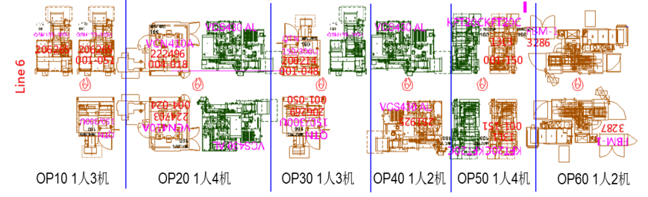
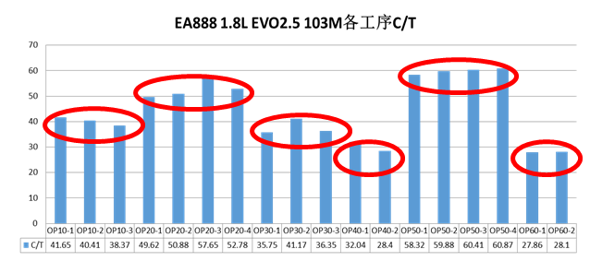
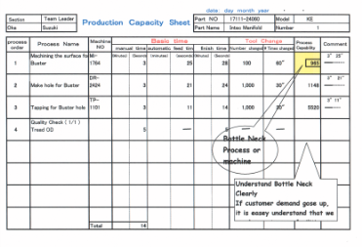
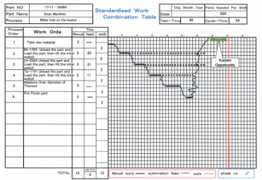
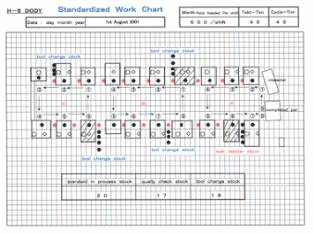
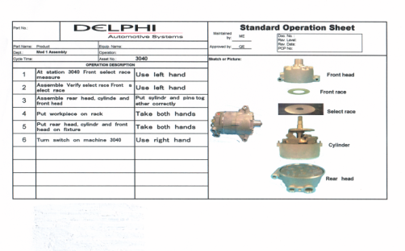
项目方案 project solution 2/5
项目目标及切入点 Project Target & The Starting Point
机加人均产出提升 Per Capita Machining Output Improvement
热工OEE提升 Thermal Process OEE Improvement
目标：Line 6线 UPPH提升20%
即UPPH: 25→30
Target: Line 6, UPPH raise 20%
As UPPH:25 →30
库存降低 Inventory Reduction
标准化及信息化 Standardization & IT Informational
善
现状Current Situation：
1.理论：5人；Theory: five people;
实际：6人；人等机浪费；
Actual: 6 people;
2.同工序各设备C/T存在10%的差异；
10% of C/T differences of same process with every machine
3.瓶颈工位OP40，C/T为15.11秒
Bottleneck OP40, C/T is 15.11 second
Line6 layout及人力配置图
改善手法：通过线平衡，工序作业改善，标准化作业，减少1名直接人员配置。
Improve technique: through line balance, process improvement, standardized operation, reduce one direct operator.
Standardized Production Capacity Sheet标准的生产能力表
Standardized Work Combination Table标准的作业组合表
Standardized Work Chart标准的工作图
Work Standard 工作标准
Notes:
生产产品： EA888 1.8L EVO2.5
EA888 1.8L EVO2.5 103M
人力配置 ：直接人力合计6人
人均产出：
瓶颈工时：瓶颈工位OP40，C/T为15.11秒
类似线体：19条

Slide 20

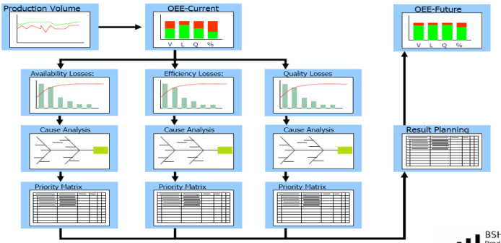
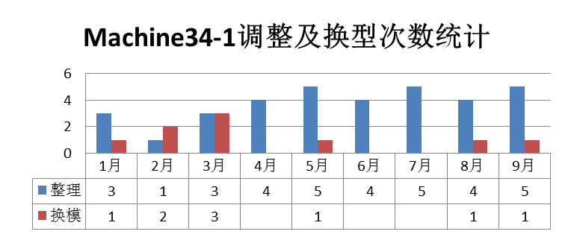
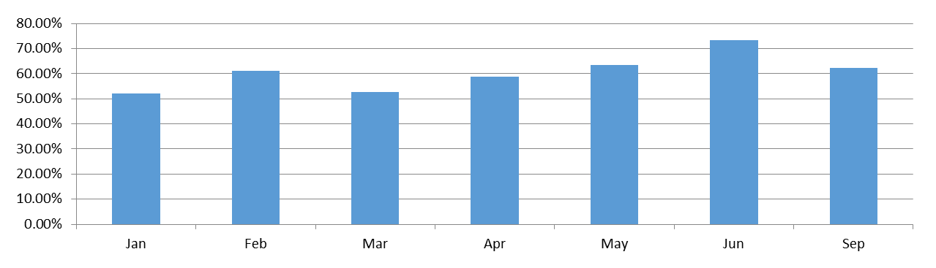
项目方案 project solution 3/5
项目目标及切入点 Project Target & The Starting Point
机加人均产出提升 Per Capita Machining Output Improvement
目标：34号浇铸机 OEE提升25%
即62% →78%
Target: No.34 Casting Machine OEE raise 25% As 62% → 75%
热工OEE提升 Thermal Process OEE Improvement
库存降低 Inventory Reduction
标准化及信息化 Standardization & IT Informational
善
34号浇铸机2016年各月OEE（平均62%）
现状Current Situation：
1. OEE: 85%*84%*87%=62 %
(2016年1~8月数据, From January to August, 2016)
2. 模具整理平均每天近2h；
The mould finishing nearly two hours a day on average
3.换模时间偏长（>6H）
Long Mould changing time
4.浇铸设备重复性故障
Casting machine repetitive failures
34号浇铸OEE损失统计分析（质量损失13%除外）
改善手法：通过SMED、整理改善OEE20%，TPM强化减少故障损失OEE5%
Notes:
平均62.47%
改善策略：
通过减少异常停机时间，及良率改善，实现OEE提升25%；即提升至78.1%；
改善措施：
1.通过缩短换型时间及全套调整时间，提升OEE5%;
2.通过浇铸模具管理改善及小整理作业改善，提升OEE15%；
3.通过强化TPM基础及浇铸设备、机械臂重复故障分析改善，提升OEE5%

Slide 21

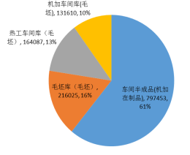
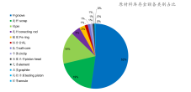
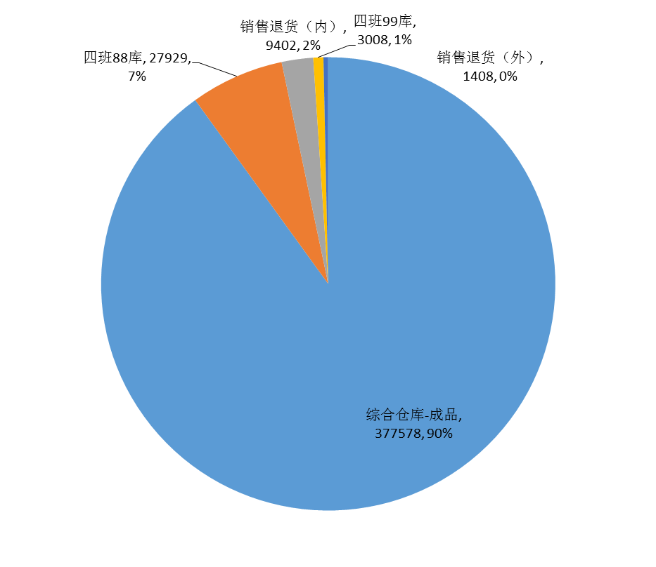
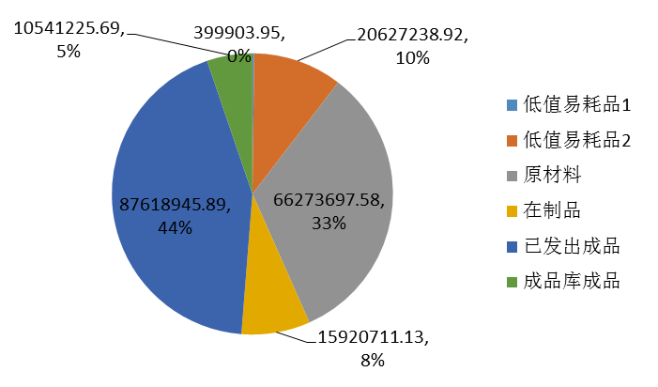
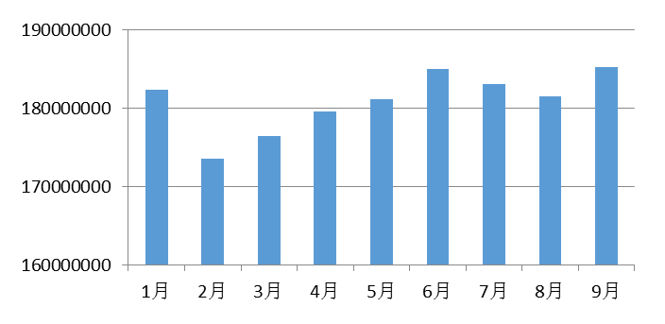
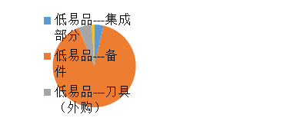
项目方案 project solution 4/5
项目目标及切入点 Project Target & The Starting Point
机加人均产出提升 Per Capita Machining Output Improvement
热工OEE提升 Thermal Process OEE Improvement
目标：库存降低20%
即降低总体库存金额2100万RMB
Target: 20% of inventory reduction,
As reduce 21 million RMB of overall inventory
库存降低 Inventory Reduction
标准化及信息化 Standardization & IT Informational
善
2016年1-9月存货变化趋势
January ~ September,2016 Inventories Trends
2016年9月存货结构分析
September,2016 Inventory structure analysis
库存现状 Current Inventory Situation：
实物库存金额：1.05亿RMB （结构分析见右图） Physical inventory amount: 105 million RMB structural analysis (see right-hand chart)
流程断点较多，信息集成度差； Many process breakpoints, poor information integration;
储备资金库存（RM+低值易耗品）存在提前或采购量偏大； Reserved asset inventory in advance or procurement is too much;
计划按天产量排产及周转 Daily plan according to production schedule and turnover
FGI
WIP
RM
低值易耗品 Low Value consumption
（储备资金库存）
Notes:
问题点：
流程断点较多； 2. 计划排产批量偏大（按天生产量周转）；
3.存在提前及超量采购/生产的情况 4. 信息集成度差，及时性及共享性待提升；

Slide 22
项目方案 project solution 4/5
项目目标及切入点 Project Target & The Starting Point
机加人均产出提升 Per Capita Machining Output Improvement
热工OEE提升 Thermal Process OEE Improvement
目标：库存降低20%
即降低总体库存金额2100万RMB
Target: 20% of inventory reduction,
As reduce 21 million RMB of overall inventory
库存降低 Inventory Reduction
改善对策
Countermeasures
标准化及信息化 Standardization & IT Informational
善
改善点
Improvement Point
改善手法：通过VSM分析打通断点，采用如下对策降低库存金额2100万RMB。
Improve technique: by VSM analysis, using the following countermeasures to reduce 21 million RMB of inventory.
项目
Project
目标
Target
降低生产库存
Reduce Production Inventory
降低生产批量
Reduce production batches
缩短生产周期
Reduce production cycle
建立拉动系统
Build pull system
小批量生产 Small batch production
精益物流、单件流 Lean logistics, one-piece flow
看板、拉动系统 Kanban、Pull system
节拍管理 TAKT management
均衡化生产 Equalization production
4%
降低成品库存
Reduce Finished Product Inventory
设置合理的库存
Set up reasonable inventory
寄售流程的检讨
Review of the consignment process
小批量生产 Small batch production
SMED及提高生产灵活性 SMED and improve production flexibility
库存策略的优化 Inventory strategy optimization
2%
降低储备资金库存
Reduce Reserve Asset Inventory
ABC分析
ABC Analysis
库存管控
Inventory management & control
生产计划/采购计划
Production/Procurement Plan
ABC物料管控法 ABC material control method
系统化的库存管控方法 Systematic inventory control method
物料需求计划/采购计划改善Improve Material requirements/procurement plan
供应商准时交付管控 Supplier delivery on time control
14%
Notes:
改善策略：
结合VSM分析打通断点、通过计划排产优化及WMS控制提前或超量采购/生产，
降低库存20%；即降低总体库存金额2100万RMB。
改善措施：
1.通过优化物料需求计划及控制原材料采购提前期及采购量，降低库存10%;
2.通过断点打通，优化计划排产及降低排产批量，降低WIP库存4%；
3.通过优化计划排产降低FGI库存2%；
4.通过低值易耗品备件管理优化，降低库存4%

Slide 23
项目方案 project solution 5/5
项目目标及切入点 Project Target & The Starting Point
机加人均产出提升 Per Capita Machining Output Improvement
热工OEE提升 Thermal Process OEE Improvement
库存降低 Inventory Reduction
标准化及信息化 Standardization & IT Informational
善
导入MES系统
Import the MES system
导入WMS系统
Import the WMS System
固化精益成果，实现数据自动采集
（产量、节拍、设备状态）；
Consolidate lean results, to achieve automatic data acquisition (production, takt, equipment status);
效率损失数字化/目视化，实现准确改善； Digitalize/Visualize of efficiency loss, achieve the accurate improvement;
生产异常实时报警，报警信号自动逐级触发，不放错一个问题，让管理看得见；Production abnormal alarm, real-time alarm signal automatically triggered by level, and not to put a wrong question, make visible management；
库存管理数字化
Inventory Digitalization
库存实时预警
Inventory Real-time Alarm
精益规范化 Lean Standardization
热工OEE改善手册 Thermal Process OEE Improvement Manual
机加工人均产出改善手册 Average Machining Output Improvement Manual
标准化排产手册 Standardized Production Scheduling Manual
库存管理标准手册 Inventory Management Standard Manual
精益标准化规范
The Lean Standard Specification

Slide 24
项目方案 project solution 5/5
项目目标及切入点 Project Target & The Starting Point
机加人均产出提升 Per Capita Machining Output Improvement
热工OEE提升 Thermal Process OEE Improvement
库存降低 Inventory Reduction
KS精益生产系统 架构图
KS Lean production system Structure
标准化及信息化 Standardization & IT Informational

Slide 25
项目方案 project solution 5/5
项目目标及切入点 Project Target & The Starting Point
KS生产管理系统
KS Production Management System
整体规划
Overall Planning
分步实施
Implementation Step By Step
机加人均产出提升 Per Capita Machining Output Improvement
热工OEE提升 Thermal Process OEE Improvement
库存降低 Inventory Reduction
标准化及信息化 Standardization & IT Informational

Slide 26
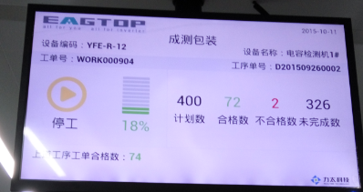
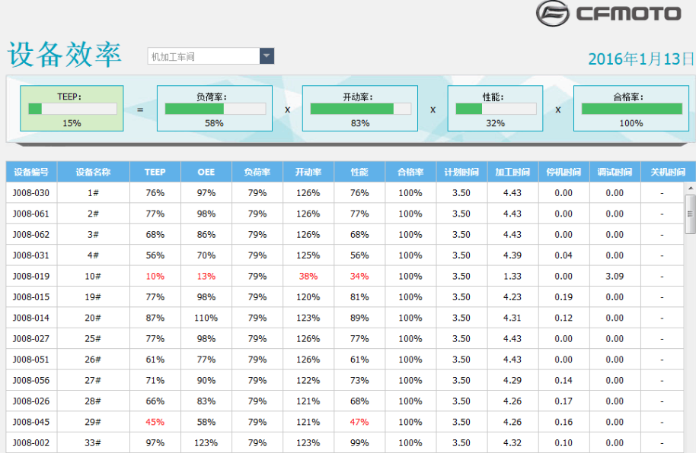
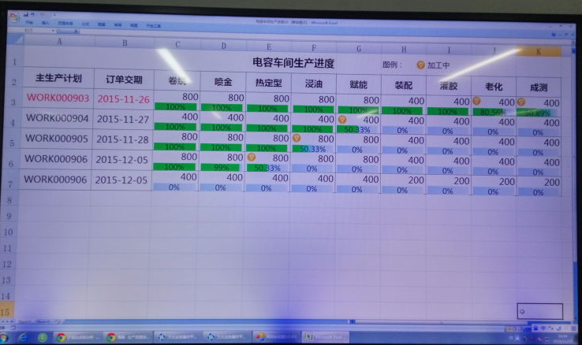
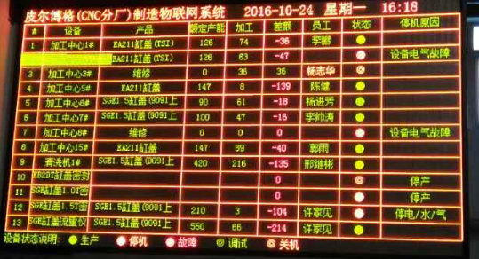
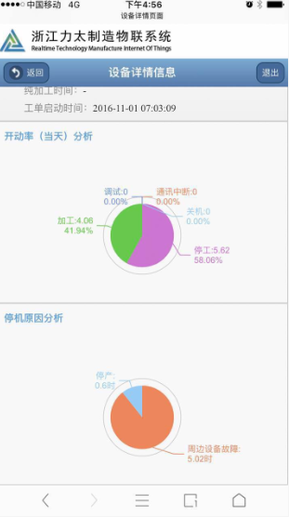
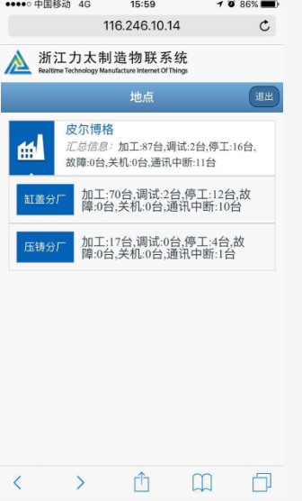
项目方案 project solution 5/5
项目目标及切入点 Project Target & The Starting Point
机加人均产出提升 Per Capita Machining Output Improvement
热工OEE提升 Thermal Process OEE Improvement
库存降低 Inventory Reduction
标准化及信息化 Standardization & IT Informational
实时监控
Real time monitoring
进度、库存、状态
Progress、Inventory、Status
全面目视
Overall Vision
电子看板 Kanban 手机iphone
仓库
车间机台/产线
办公

Slide 27
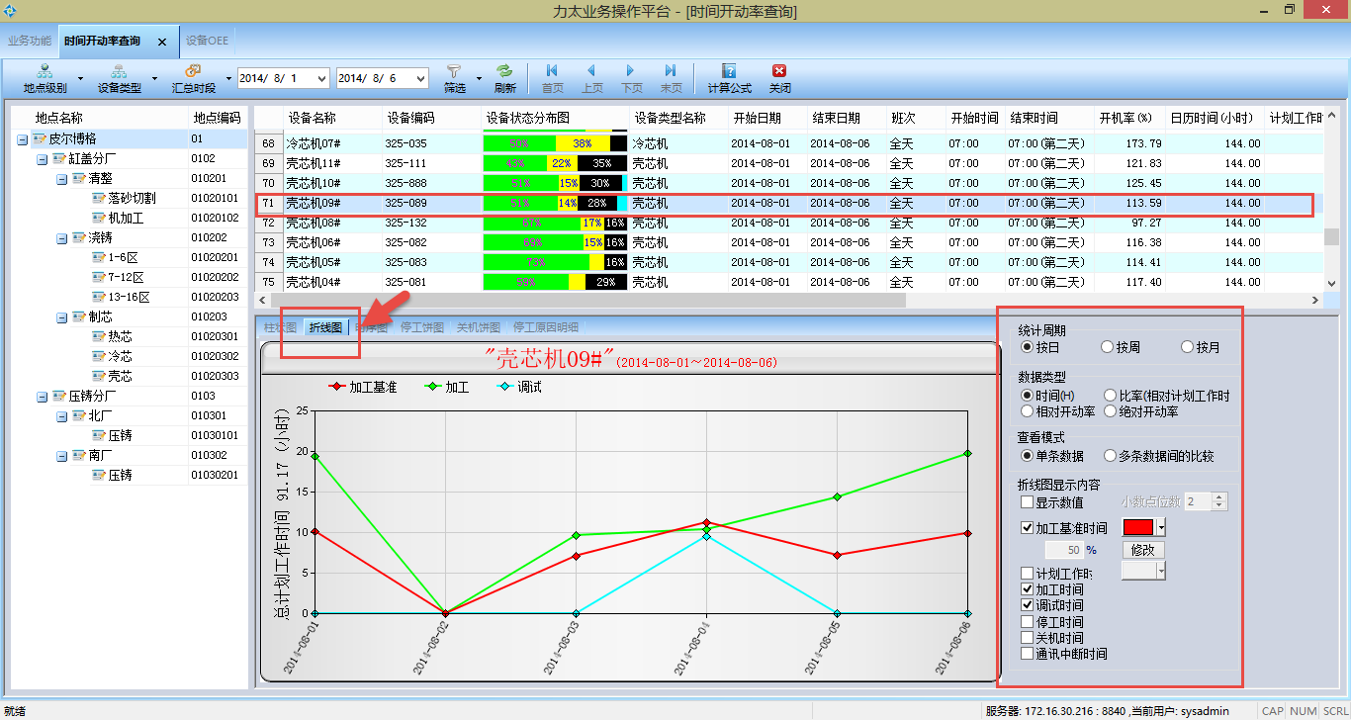
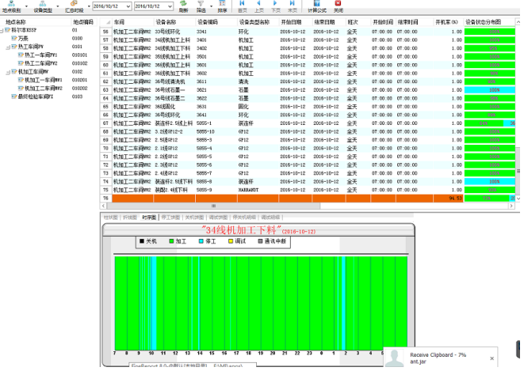
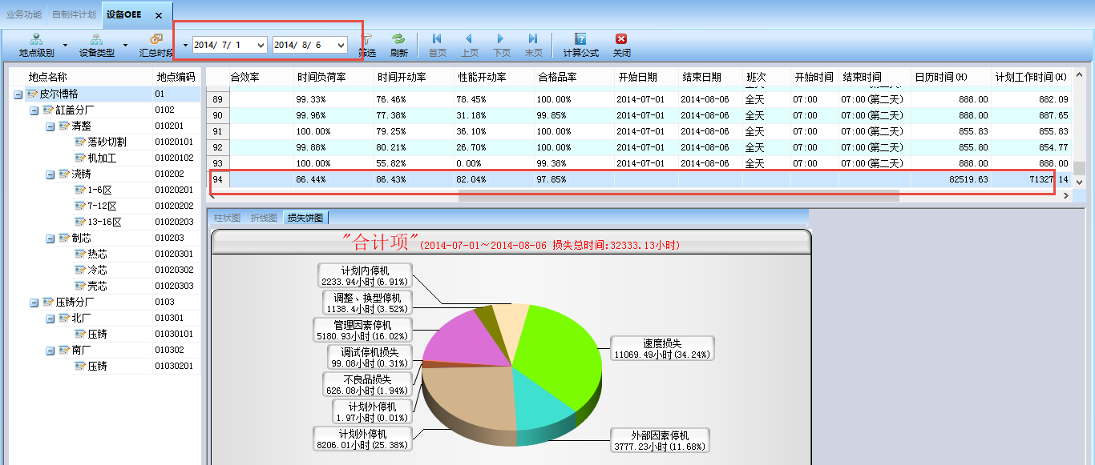
项目方案 project solution 5/5
项目目标及切入点 Project Target & The Starting Point
机加人均产出提升 Per Capita Machining Output Improvement
热工OEE提升 Thermal Process OEE Improvement
深度分析
Profundity Analysis
OEE OTD MTTB
库存降低 Inventory Reduction
标准化及信息化 Standardization & IT Informational
实时监控
Real time monitoring
生产 设备
深度分析
Profundity Analysis
OEE OTD MTTB

Slide 28
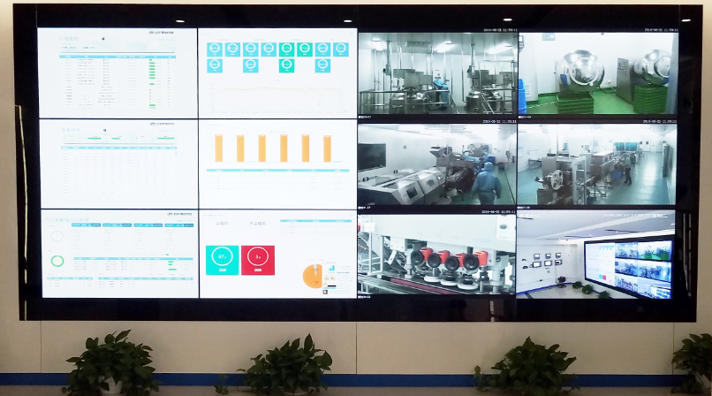
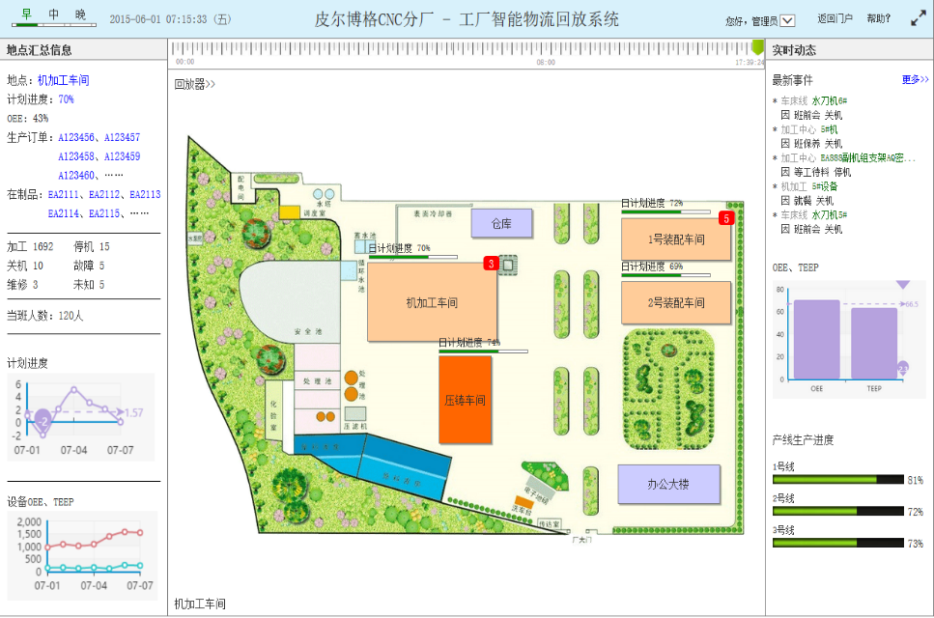
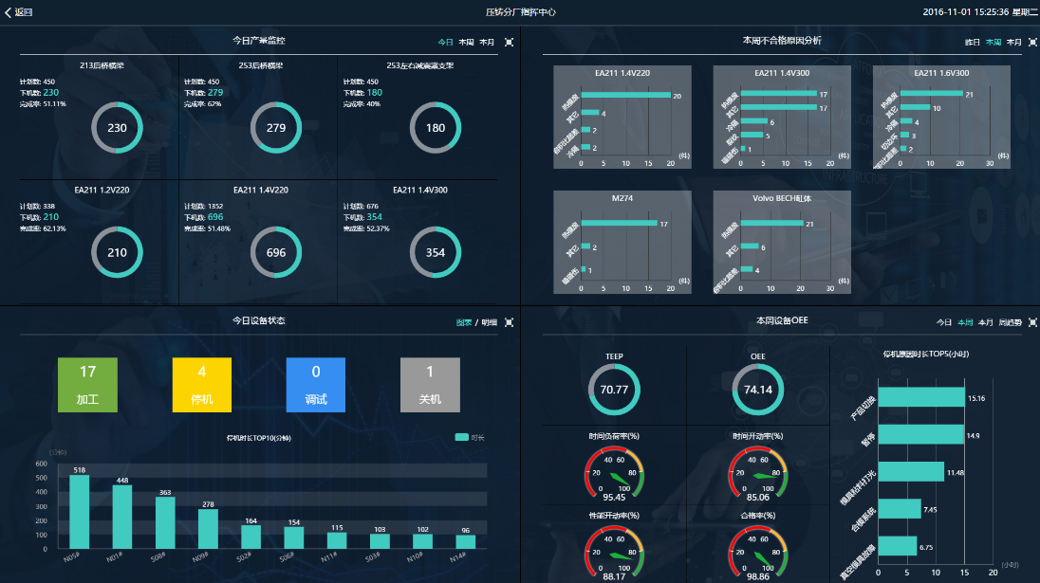
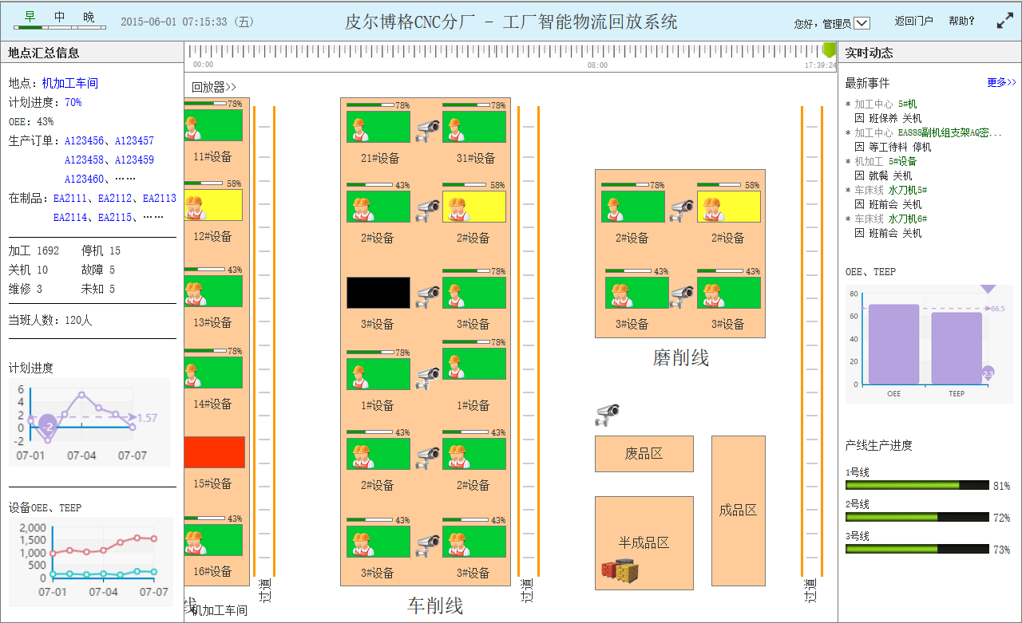
项目方案 project solution 5/5
项目目标及切入点 Project Target & The Starting Point
机加人均产出提升 Per Capita Machining Output Improvement
热工OEE提升 Thermal Process OEE Improvement
库存降低 Inventory Reduction
标准化及信息化 Standardization & IT Informational
全面目视
Overall Vision
智能指挥中心 Intelligent Command Center
大数据分析
Database
工厂地图 Factory Layout

Slide 29
领导讲话
Leaders’ Speech

